Slide 1
Fundamentals of Data Representation Lesson 4
Character Encoding

Slide 2
Silent Hook
00101101
00011110
01010101
10100000
Add these three binary numbers and write your answer on your mini whiteboard

Slide 3
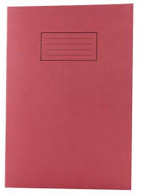
Learning Objectives
Understand and apply a binary shift and where they can be used
Understand character sets ASCII and Unicode

Slide 4
Binary Shift
Also known as a ‘Logical Shift’.
Process of shifting all the bits either left or right by a given number of places.
Used to perform simple multiplication or division by the power of 2

Slide 5
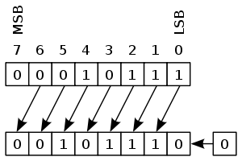
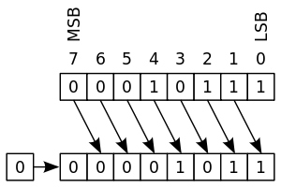
Binary Shift
Binary number 00010111 (decimal 23)
Left Binary Shift - Right Binary Shift
Multiplied by two to become decimal 46
Divided by two to become decimal 11

Slide 6
Character sets
When you press a key on a keyboard a code is generated that the computer can convert into a symbol for display or printing (Output).
It is clear that it is important that systems agree on the codes being used if the data is to make sense. In 1960 the American Standards Association agreed on a set of codes to represent the main character set used in telegraph systems.
ASCII (American Standard Code for Information Interchange). This system was agreed to deal with basic textual messages and included codes for punctuation.

Slide 7
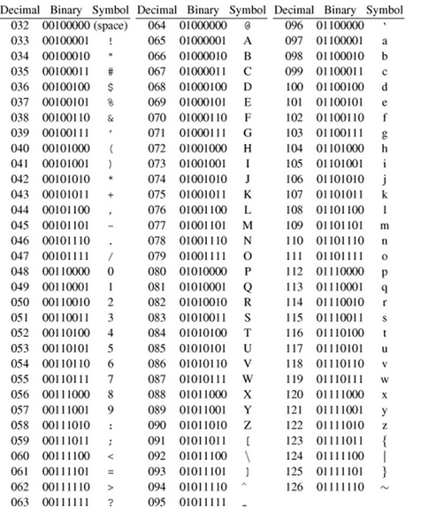
ASCII
Binary values increase from A-Z so enabling programs to sort using a numerical value
ASCII has only 127 possible characters so is limited in what can be represented.
In total, 127 codes (95 printable and 32 non-printable) plus the 'null' code (represented by the binary 00000000) which is used as a control character in certain applications but has no associated symbol. In binary, 127 is 1111111, so this system uses 7 bits.
Note a (lowercase) is a higher number than Z (uppercase) so ‘Zebra’ will come before ‘apple’

Slide 8
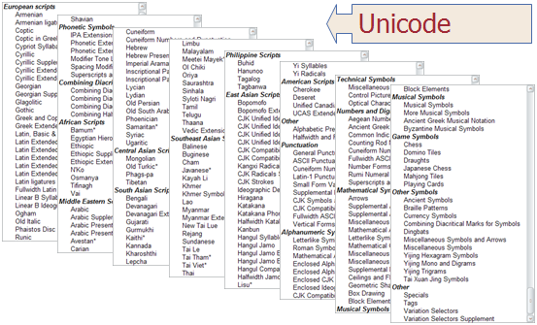
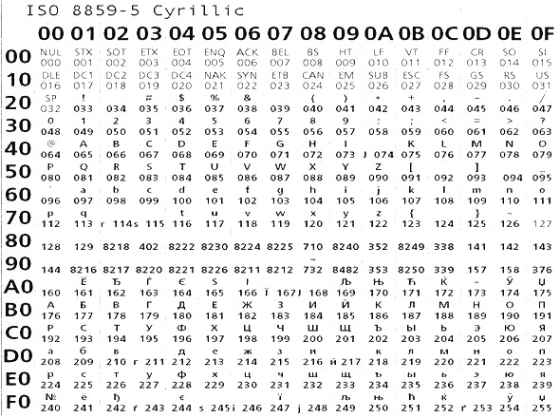
Unicode
The UNICODE system for encoding characters uses up to 32 bits (4bytes) providing more than 4 billion possibilities. It is now the standard character set used for computers.
Within the Unicode system the original 128 ASCII characters still occupy the same values, so ASCII could now be considered a subset of the Unicode System for coding characters.
This means older machines using the ASCII character set will still be able to communicate with newer machines using UNICODE.

Slide 9
Task
In your books, answer the following questions: 1. What is meant by the character set of a computer? 2. Explain how ASCII represents each character set of a computer. 3. What happens if you sort the list 'Apple', 'bear', 'Charlie', 'dog', 'elephant' in a program using ASCII or Unicode to represent the character set? 4. Explain the difference between using an ASCII character set and a Unicode character set?

